Slide 1
QUIZVERSE
REVOLUTIONIZING EXAMINATION EXPERIENCE
GROUP NO. 13
PROJECT GUIDE : Asst Prof SREEDEEPA H S
PRESENTED BY,
ADR21CS032 JELAN MATHEW JAMES
ADR21CS059 SUJITH T S
ADR21CS034 JOEL SIBY VARGHESE
ADR21CS042 N HARIKRISHNAN
ADR21CS053 SABARINATH O

Slide 2
INTRODUCTION
OBJECTIVES
EXISTING SYSTEM
HARDWARE AND SOFTWARE REQUIREMENTS
PROPOSED SYSTEMS
SYSTEM DESIGN
CONCLUSION
REFERENCES
OUTPUT
INDEX

Slide 3
INTRODUCTION
A revolutionary web application transforming the examination experience.
QuizVerse aims to address the shortcomings of traditional examination methods by offering a versatile platform for conducting rigorous examinations and engaging quizzes.
Our presentation will explore the challenges faced by traditional examination methods and how QuizVerse provides innovative solutions to overcome them.

Slide 4
OBJECTIVES
QuizVerse is a web application designed to revolutionize the examination experience.
QuizVerse offers a versatile platform for conducting rigorous examinations and engaging, knowledge-testing quizzes.
Application contains Faculty console for conducting tests and analysis of student performance.
Student role users can attend viva and submit their answers. Community role users can create general quizzes that can be accesses by others.

Slide 5
EXISTING SYSTEM

Slide 6
Security Concerns:
Vulnerabilities in authentication may lead to cheating or breaches in exam integrity.
Lack of robust encryption and data protection measures could compromise student privacy and assessment confidentiality.
EXISTING SYSTEM
LIMITATIONS
Compatibility issues with different devices and browsers may disrupt the examination process for both educators and students
System downtime or slow performance during peak usage times could impede the smooth conduct of exams and result processing
Technical Issues:

Slide 7
QUIZVERSE SYSTEM DESIGN

Slide 8
Admin
Admins oversee system operations, managing Institution and Community Admins.
Institution Admin
. Institution Admins handle faculty assignments, student creation, and course management.
User Roles and Permissions
Community admin
Community Admins initiate community-based quizzes.
Faculty
Faculty members can conduct exams, create question sets, select students, and analyse performance
Student
Students participate in exams and review their individual performance

Slide 9
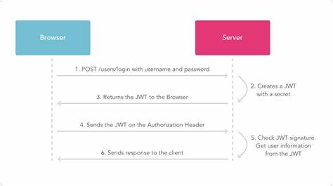
USER AUTHENTICATION – TOKEN BASED AUTHENTICATION
User registration is done by adding user details to database through api’s
User signin is done by providing email or username with password
TECHNOLOGIES USED
Token based authentication is implemented using JWT Technology
Basic Flow
User Schema:
id varchar(36)
username varchar(50)
email varchar(50)
password varchar(150)
is_verified tinyint(1)
created_at datetime(6)
updated_at datetime(6)
Login Schema:
username_or_email: str
password: str

Slide 10
DIAGRAMS

Slide 11
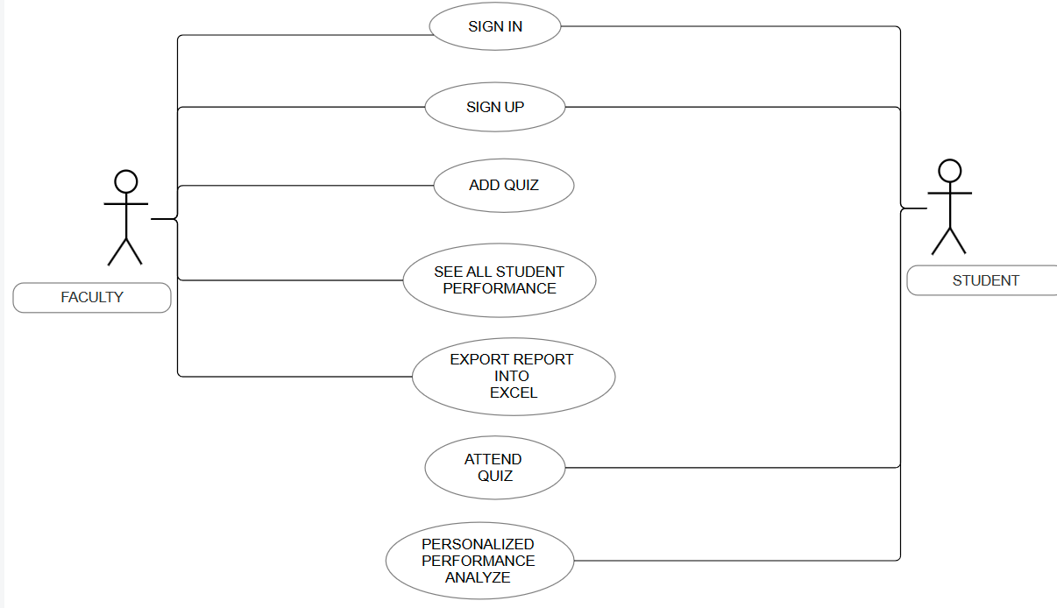
FACULTY – STUDEDNT USE CASE DIAGRAM

Slide 12
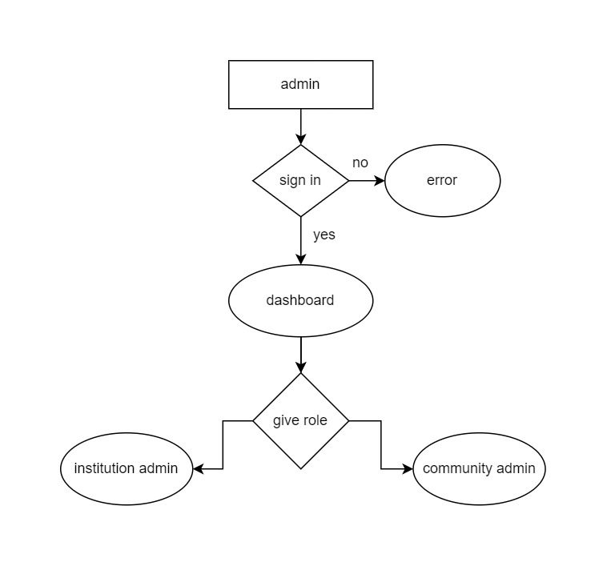

Slide 13
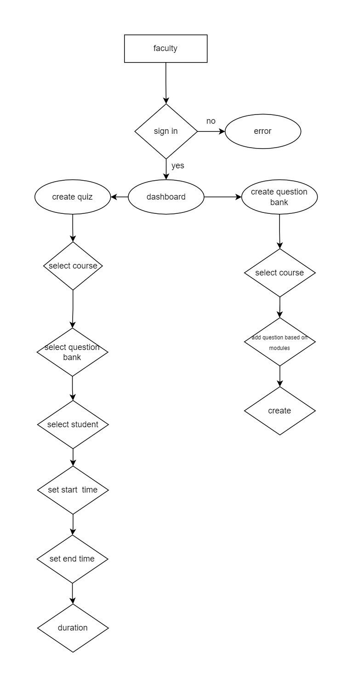

Slide 14
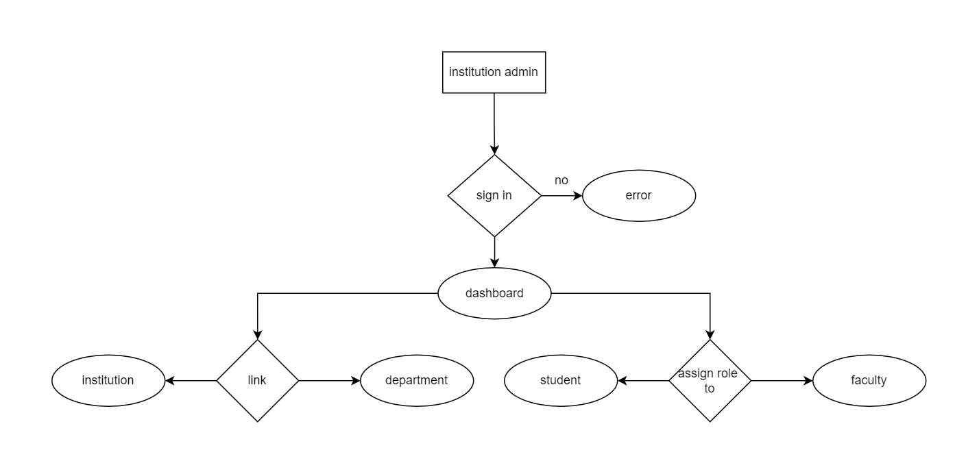

Slide 15
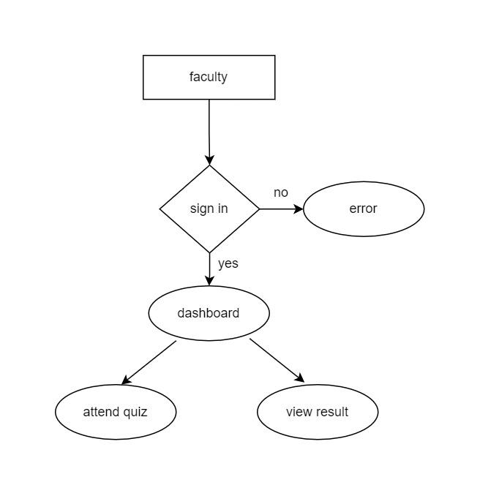
student

Slide 16
DATABASE DESIGN

Slide 17
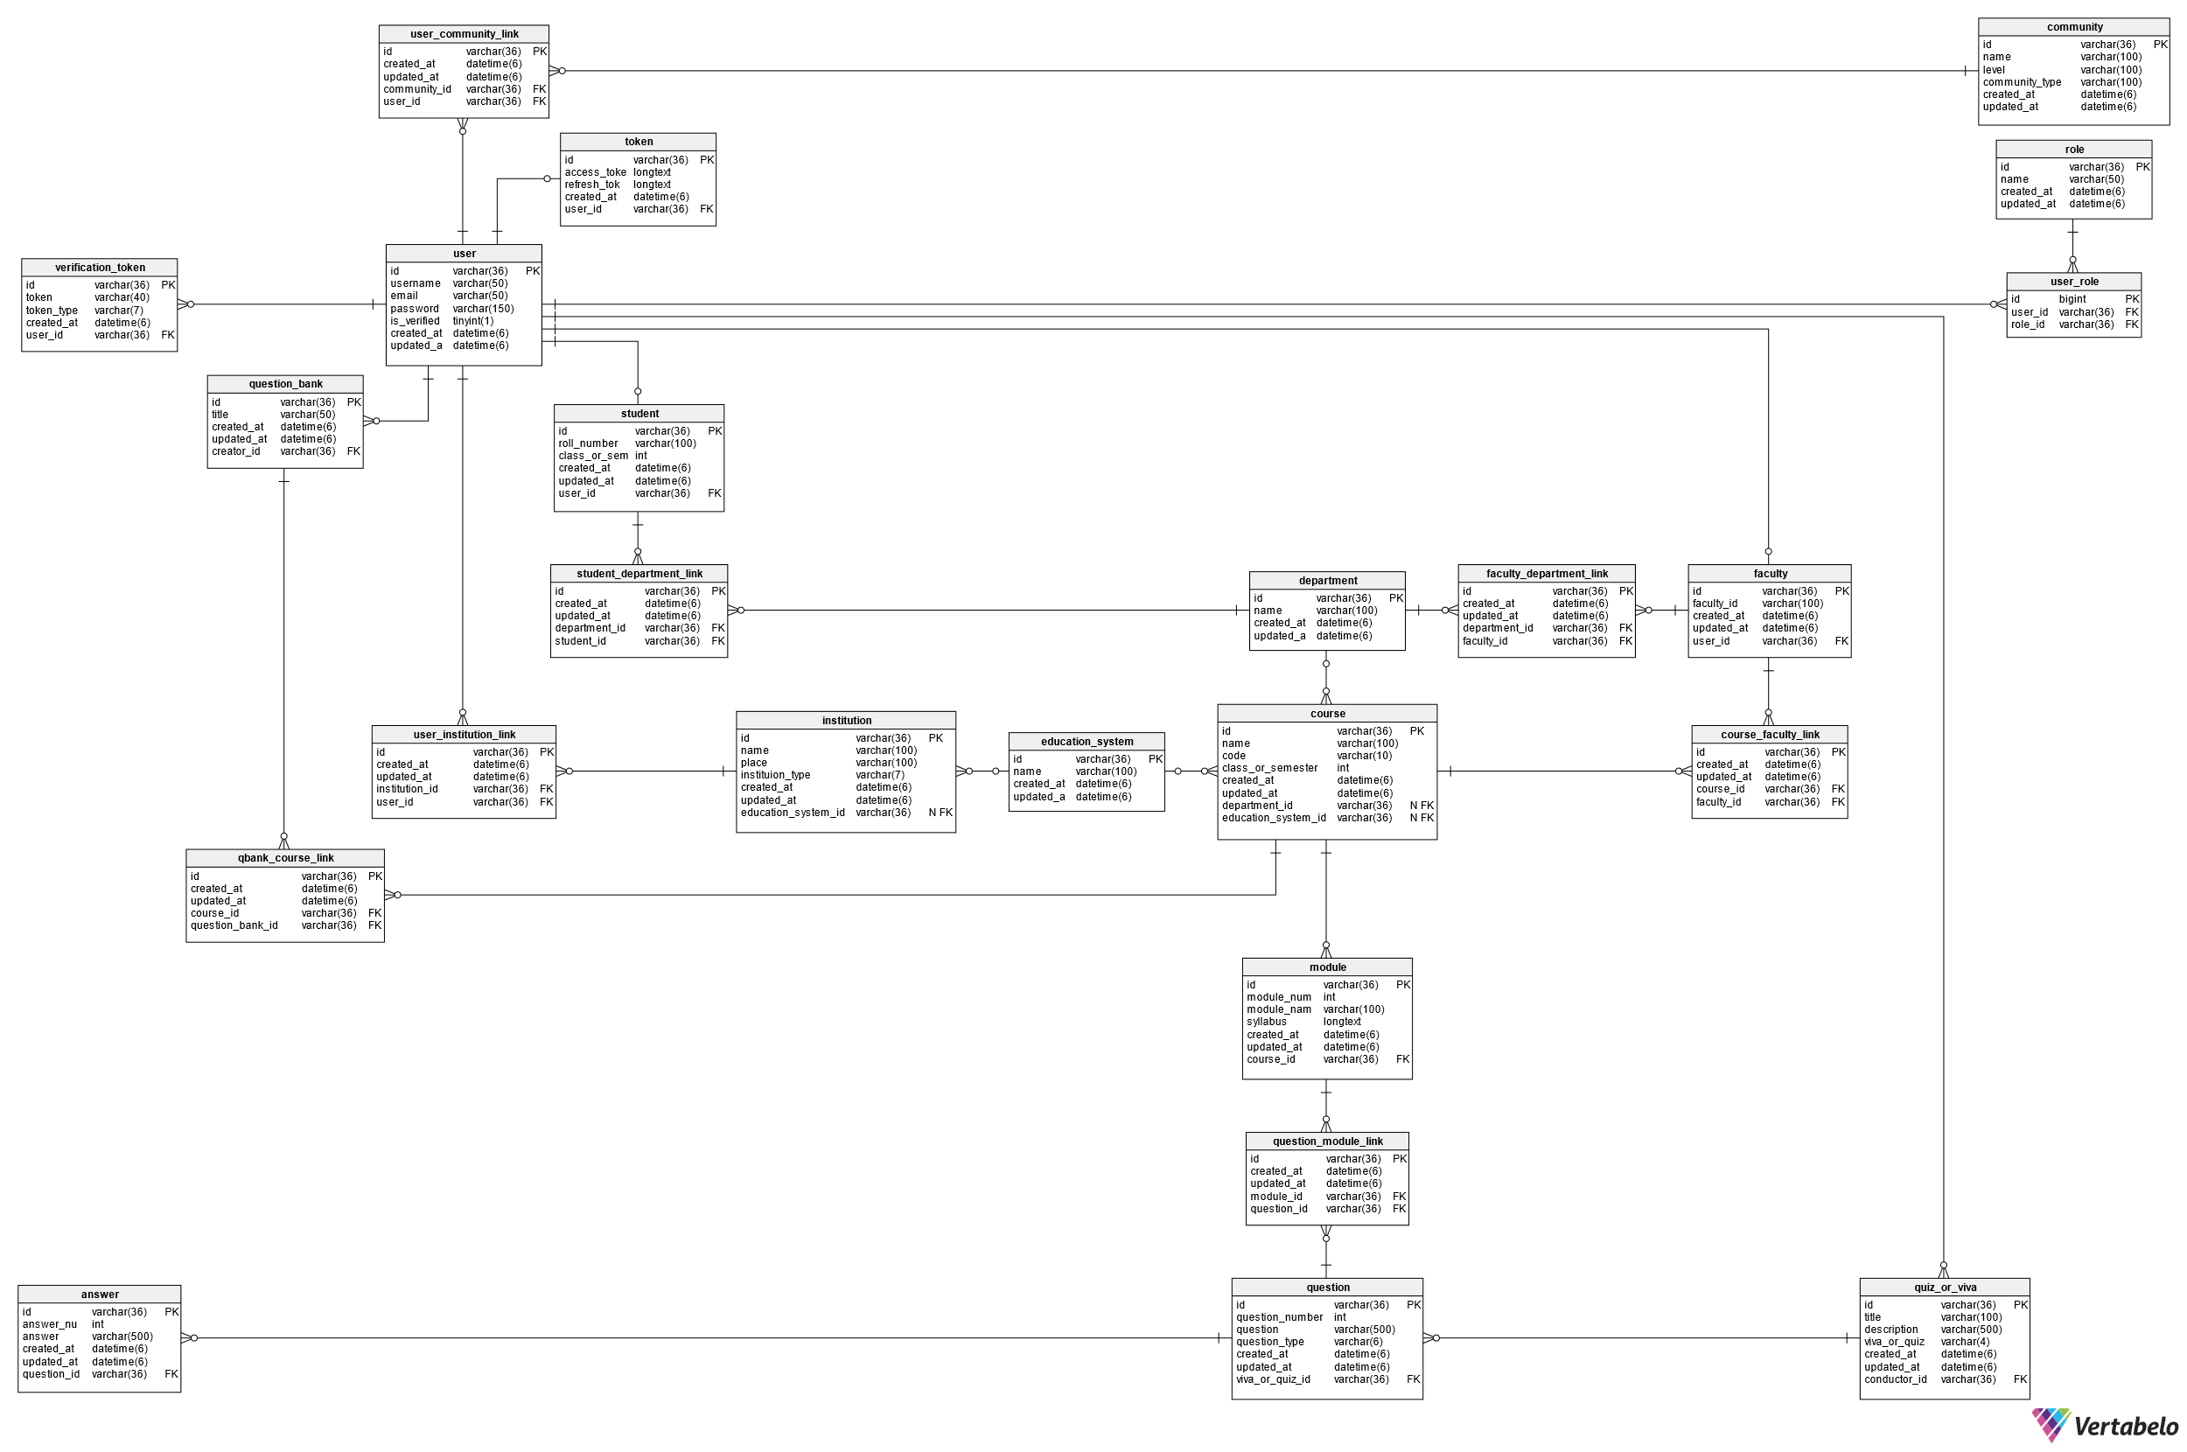

Slide 18
SOFTWARE AND HARDWARE
REQUIREMENTS
SOFTWARE REQUIREMENTS
OS: UBUNTU 22.04 LTS
API DEVELOPMENT: DJANGO NINJA
DATABASE: PostgreSQL
FRONT END: React
UI/UX: Figma
STYLING: Tailwind CSS
CLOUD PROVIDER: DigitalOcean
VERSION CONTROLLER: Git
CODE REPOSITORY: GitHub
HARDWARE REQUIREMENT
CPU: Basic Intel i3 1215u
GPU: Not required
RAM: 8GB
SSD: 240GB

Slide 19
Detailed Reports
Detailed reports break down student scores by module, enabling targeted improvement strategies.
Personalized metrics
Students can access personalized performance metrics based on their responses to module-specific questions
FEATURES
Export to Excel
Educators can export student scores to Excel for further analysis and intervention planning.

Slide 20
Secure Examination Environment
QuizVerse ensures a secure examination environment by implementing robust security measures and anti-cheating techniques
Randomized question bank
Mouse point tracking
Browser tab tracking
Time limits to uphold fair and reliable assessment outcomes.

Slide 21






Front End
Back End
Vite+React
Python
Django
Figma
TECHNOLOGIES USED
Tailwind CSS
Django Ninja

Slide 22
OUTPUT

Slide 23
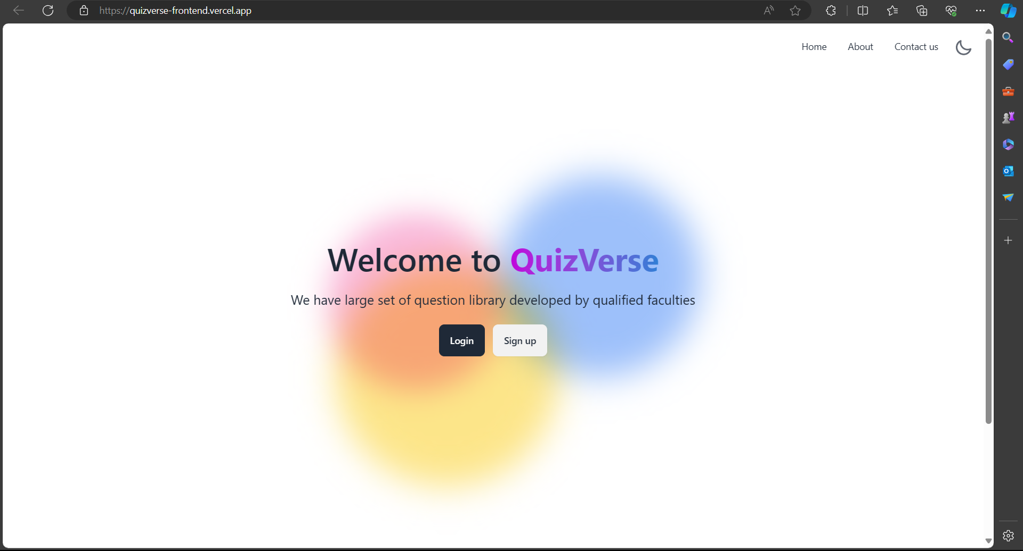

Slide 24
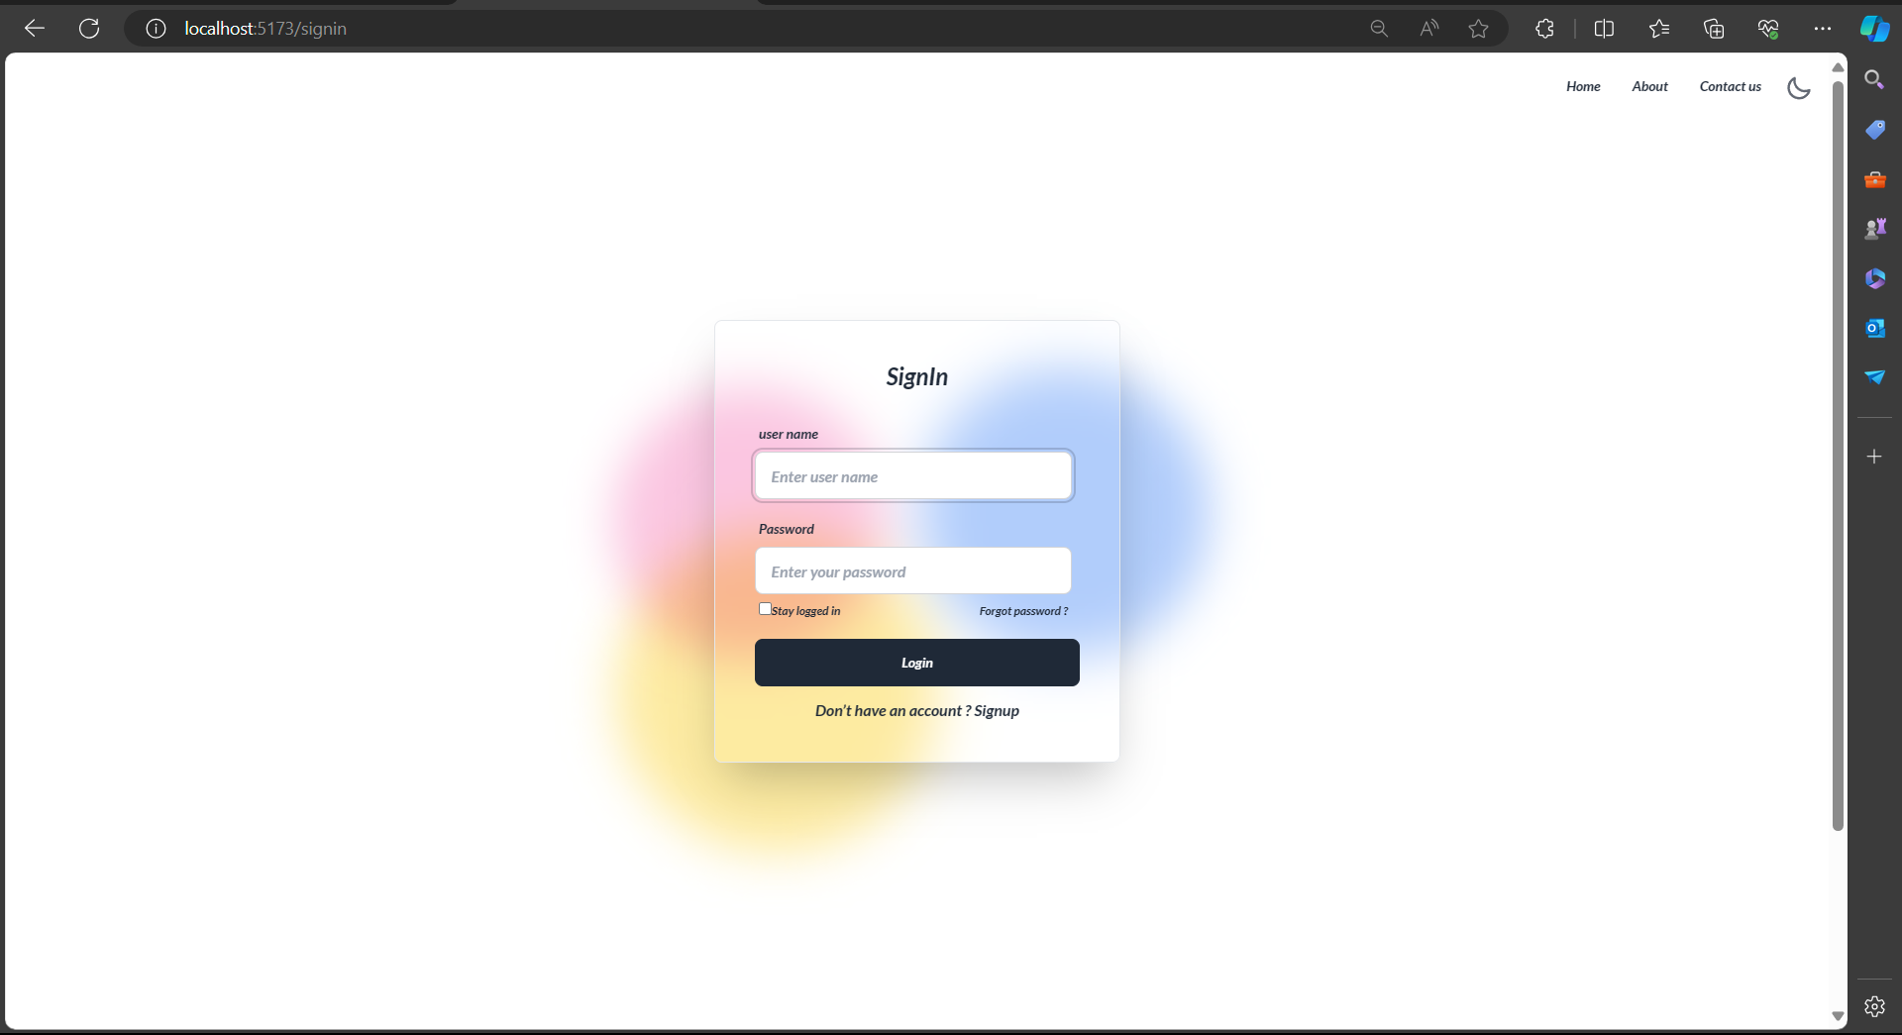

Slide 25
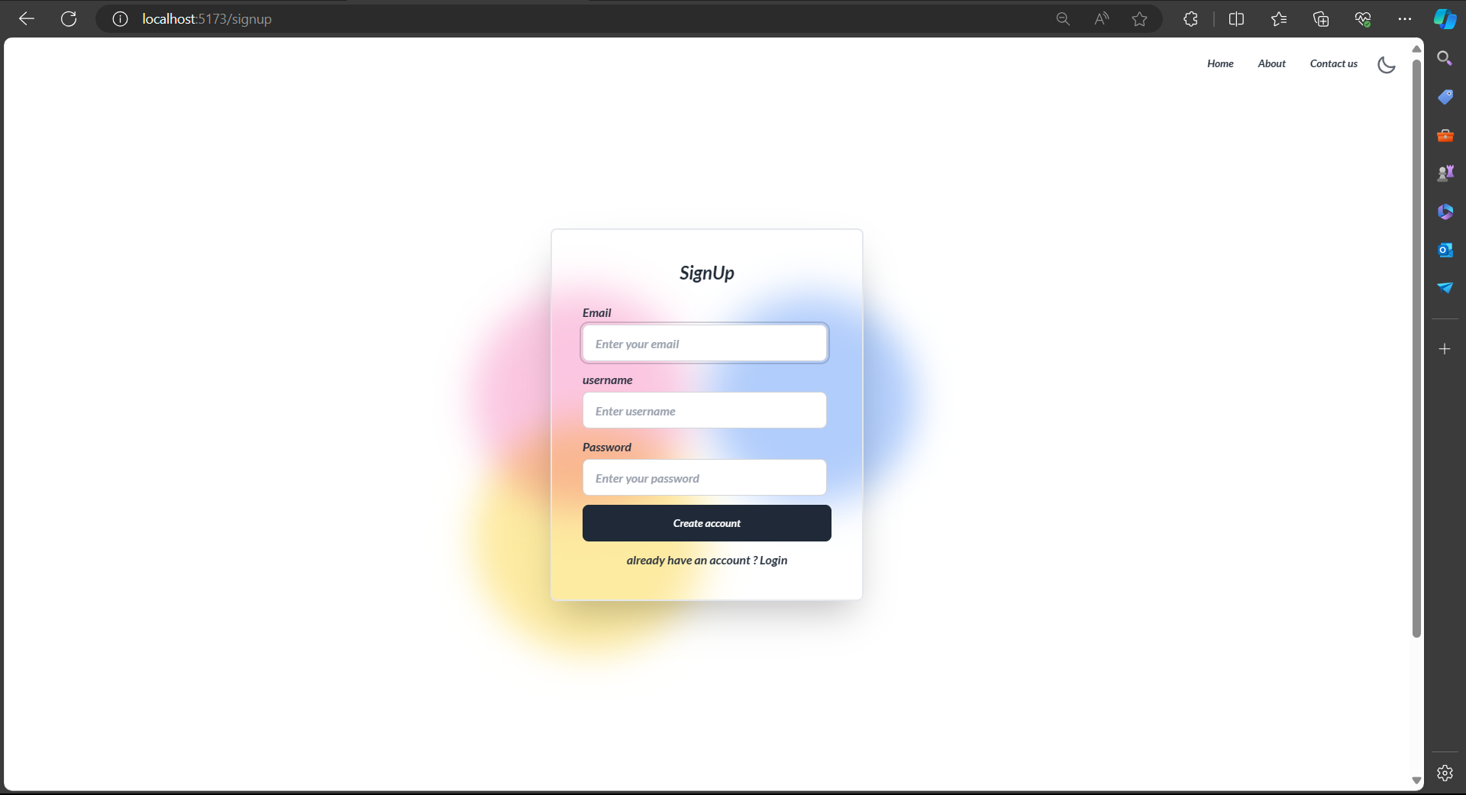

Slide 26
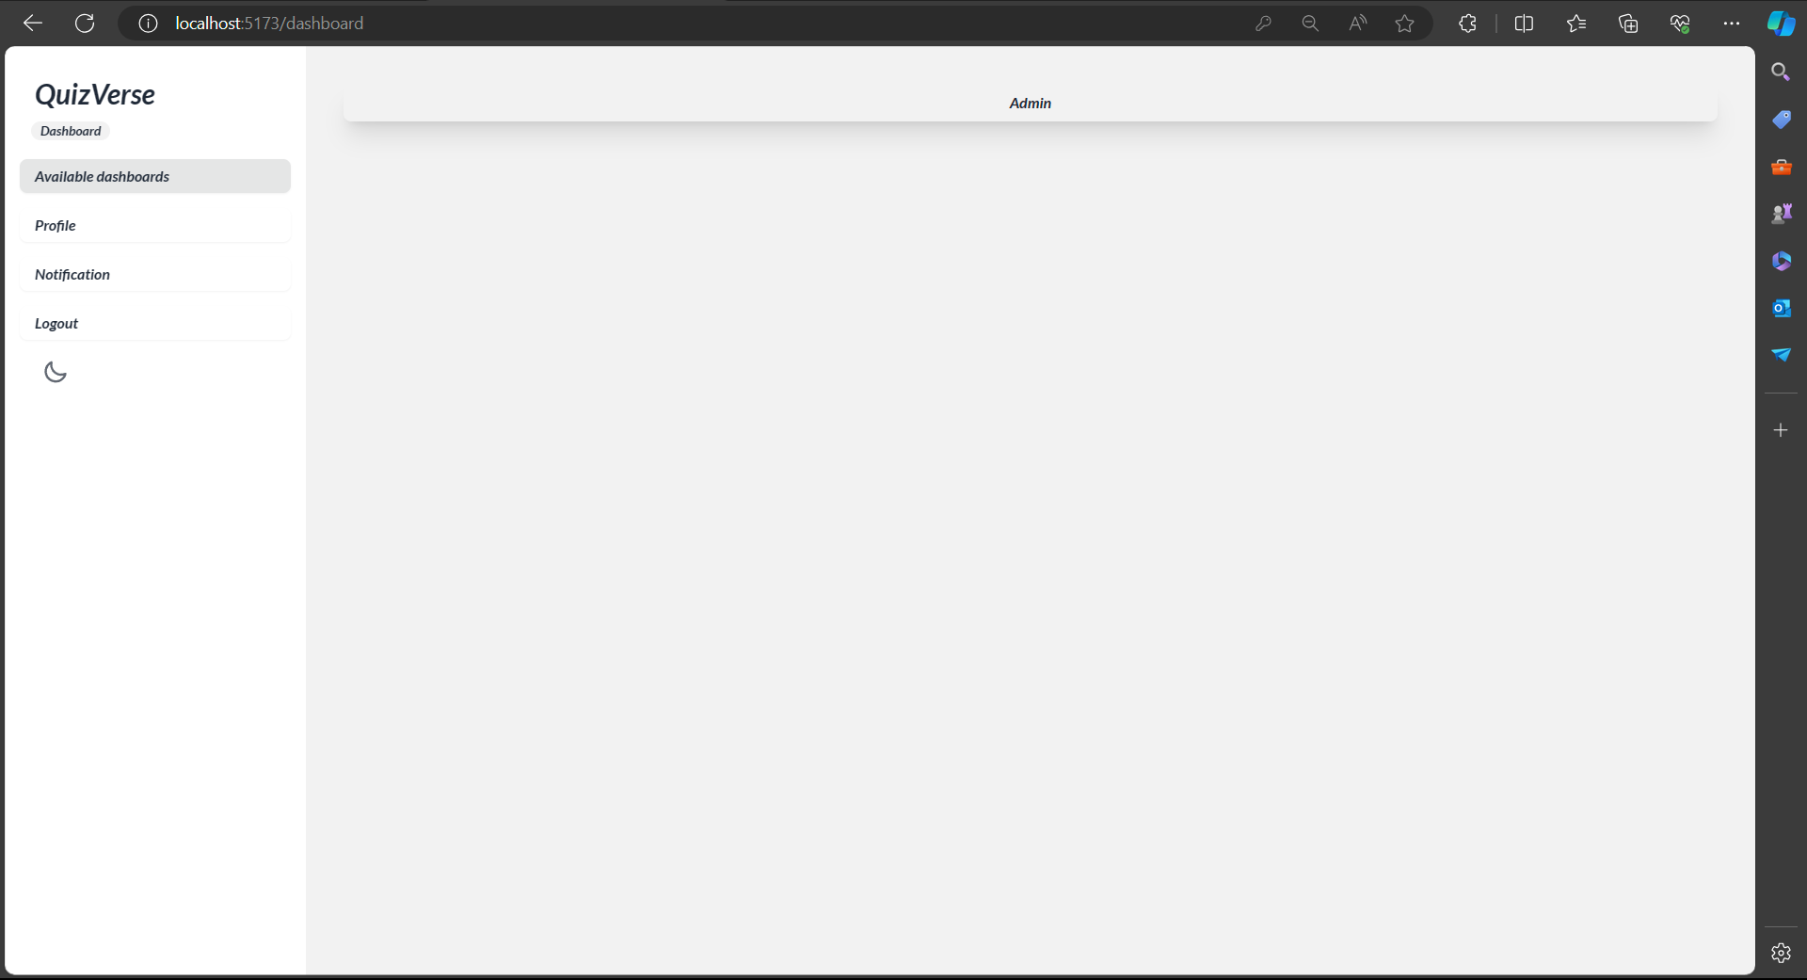

Slide 27
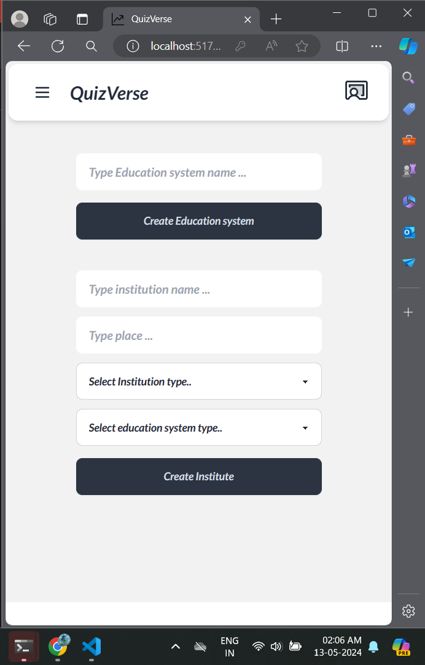
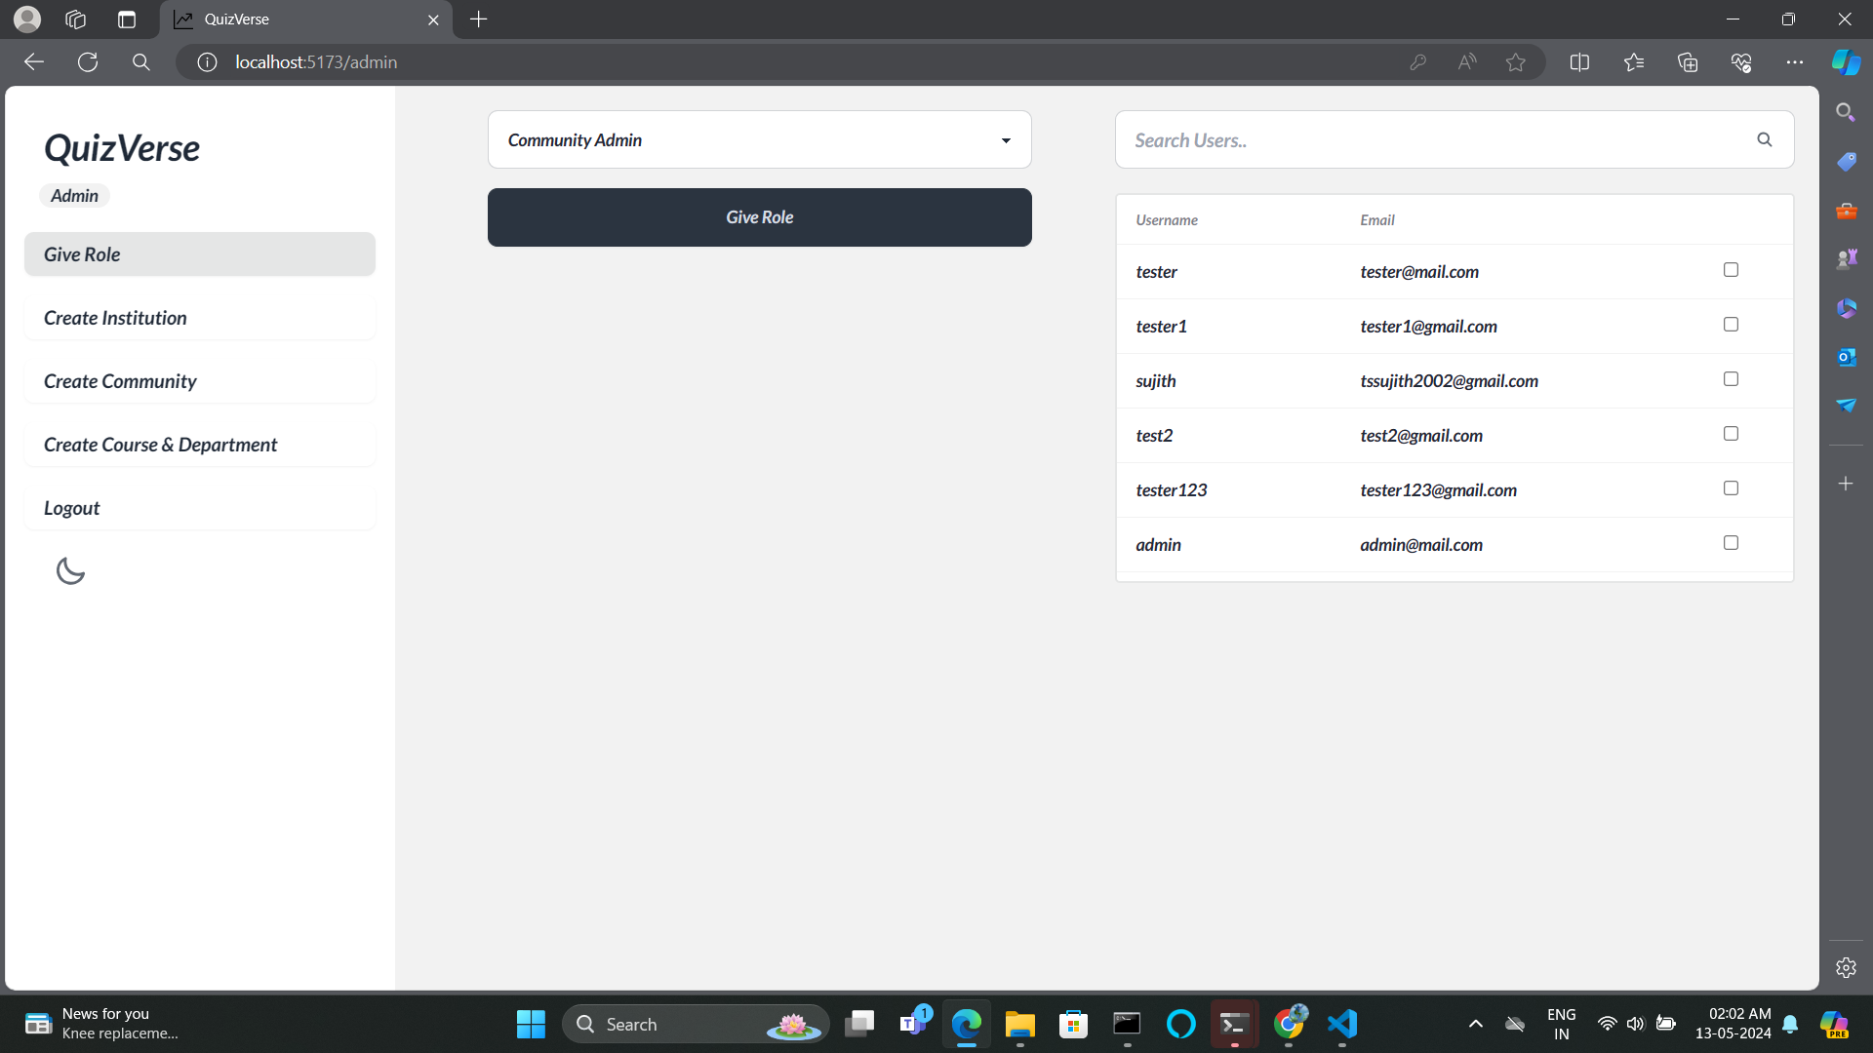

Slide 28
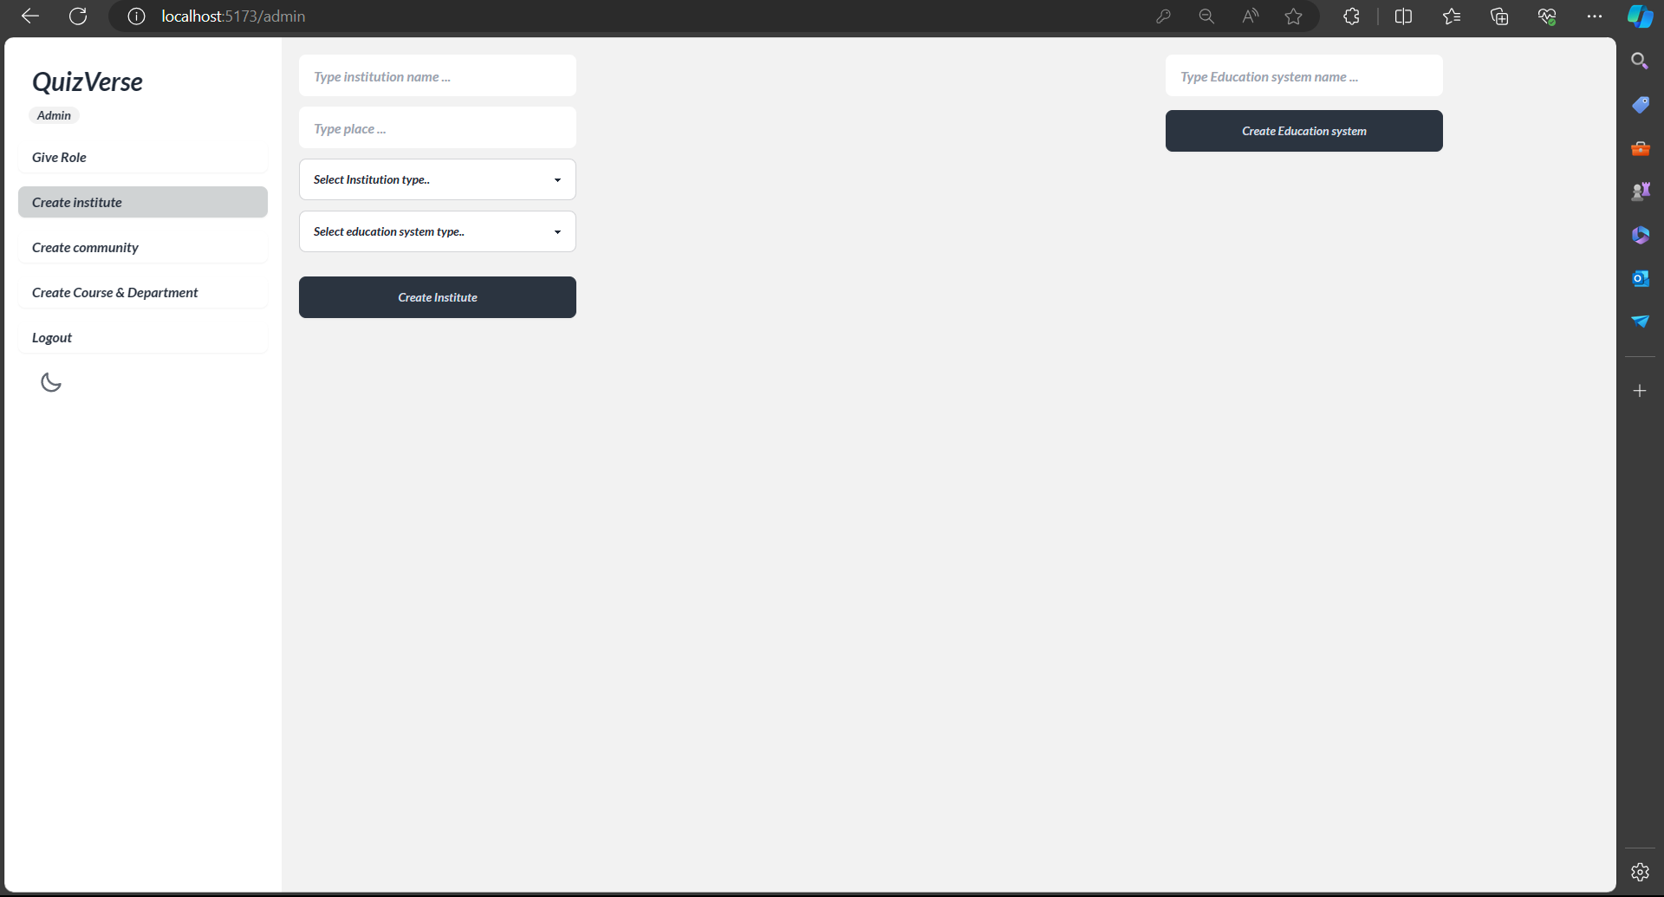

Slide 29
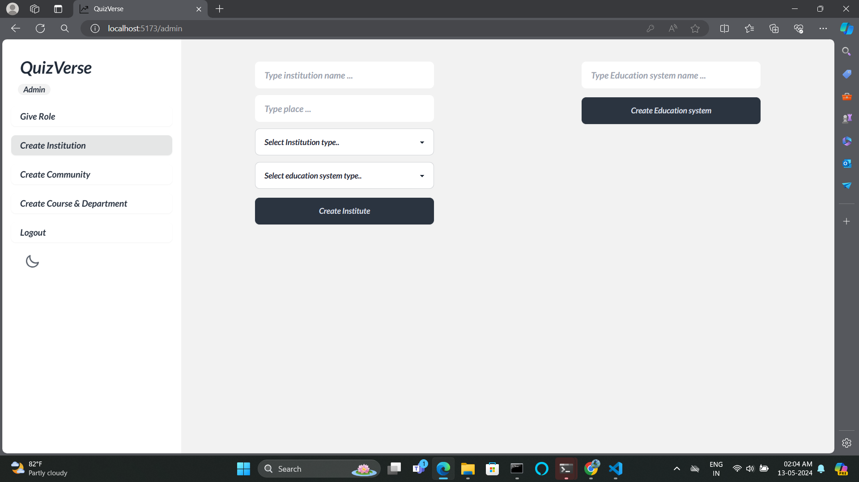
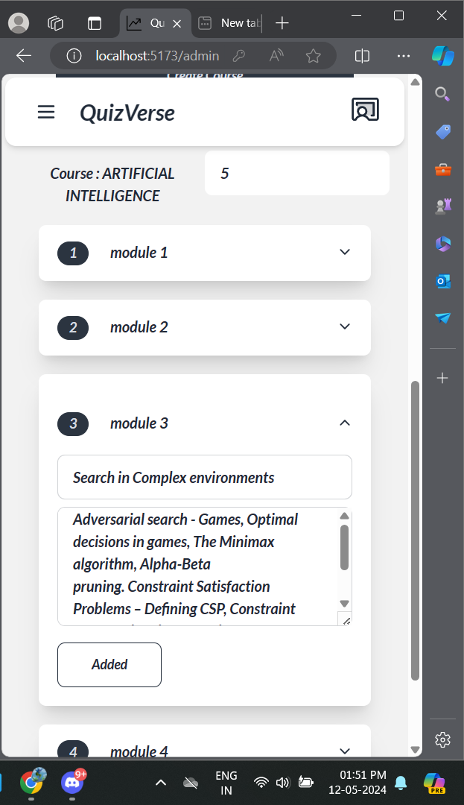

Slide 30
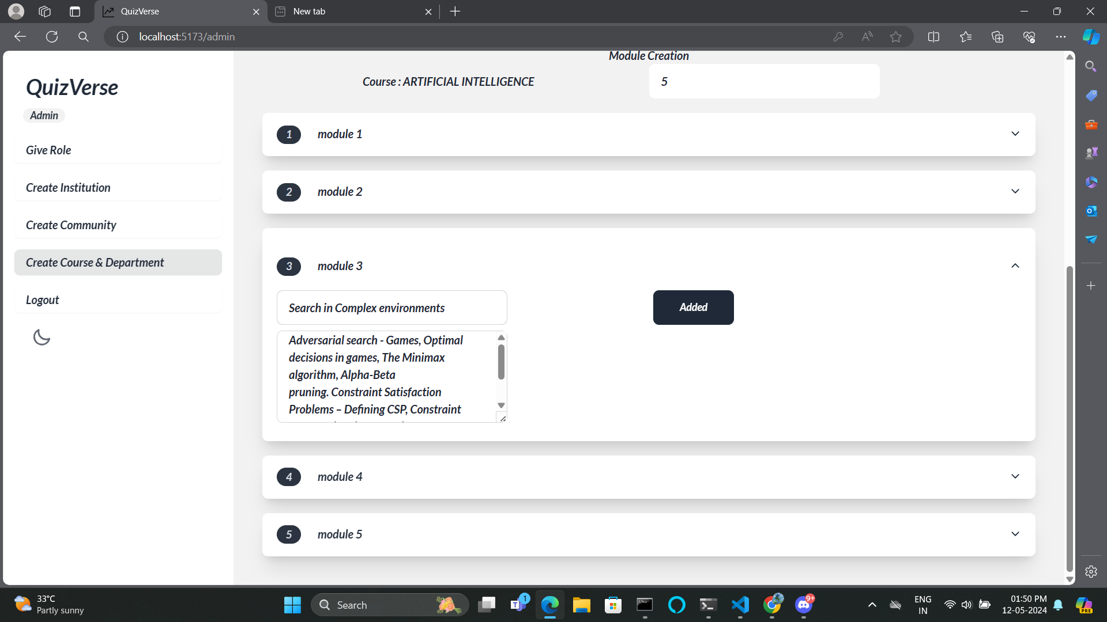
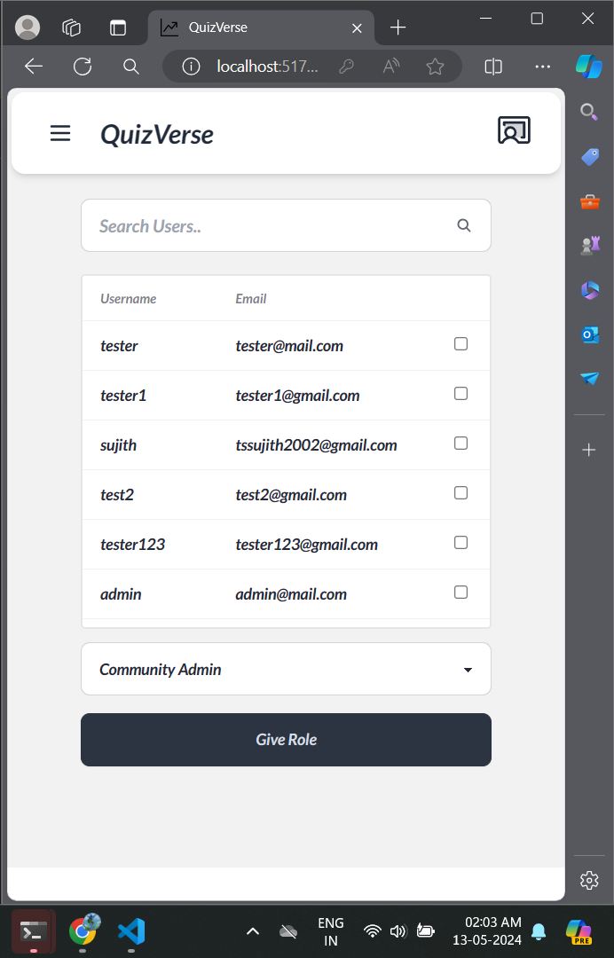

Slide 31
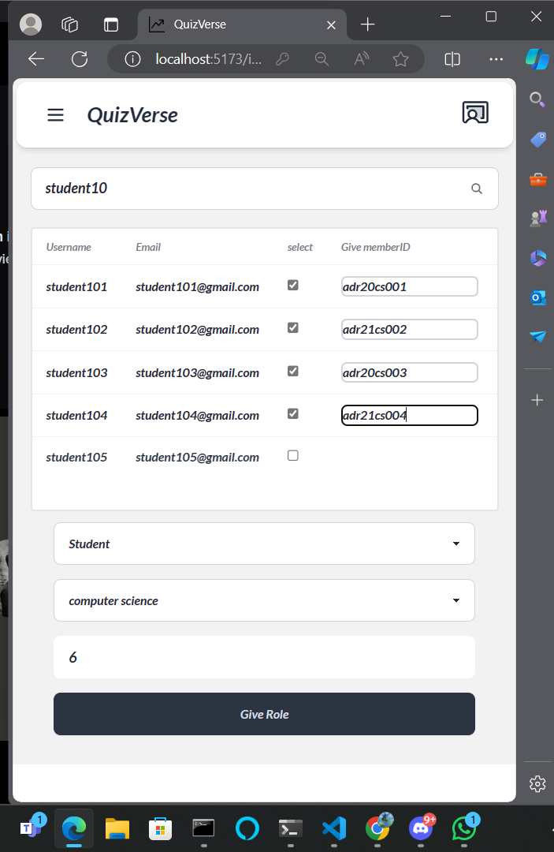

Slide 32
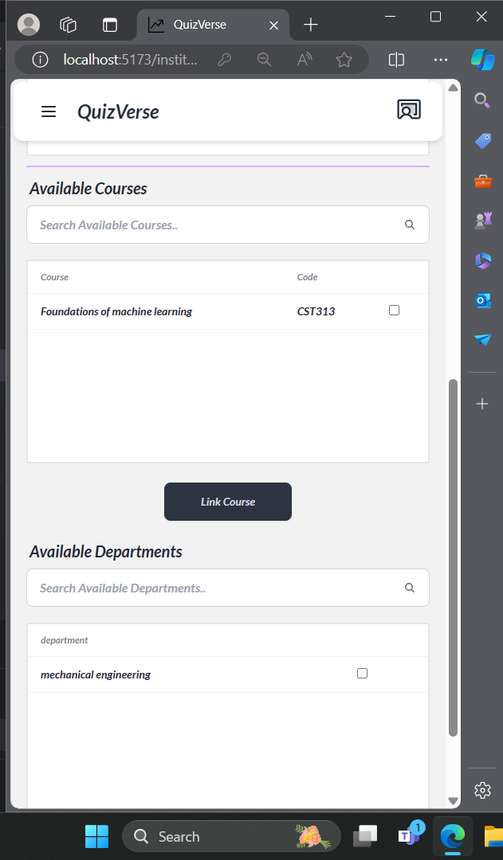
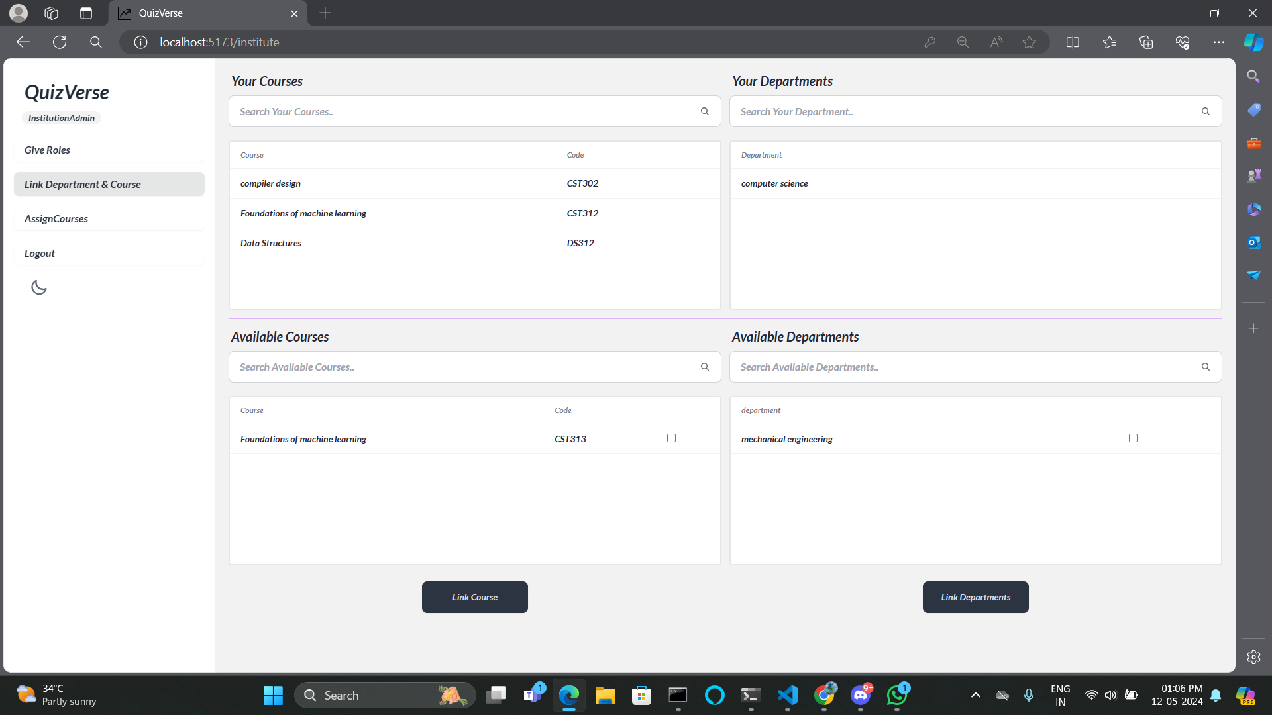

Slide 33
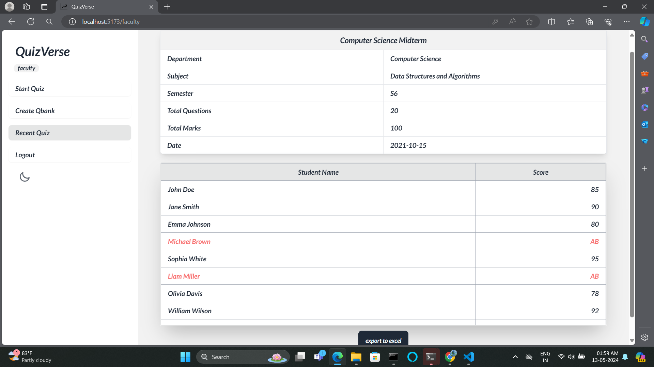
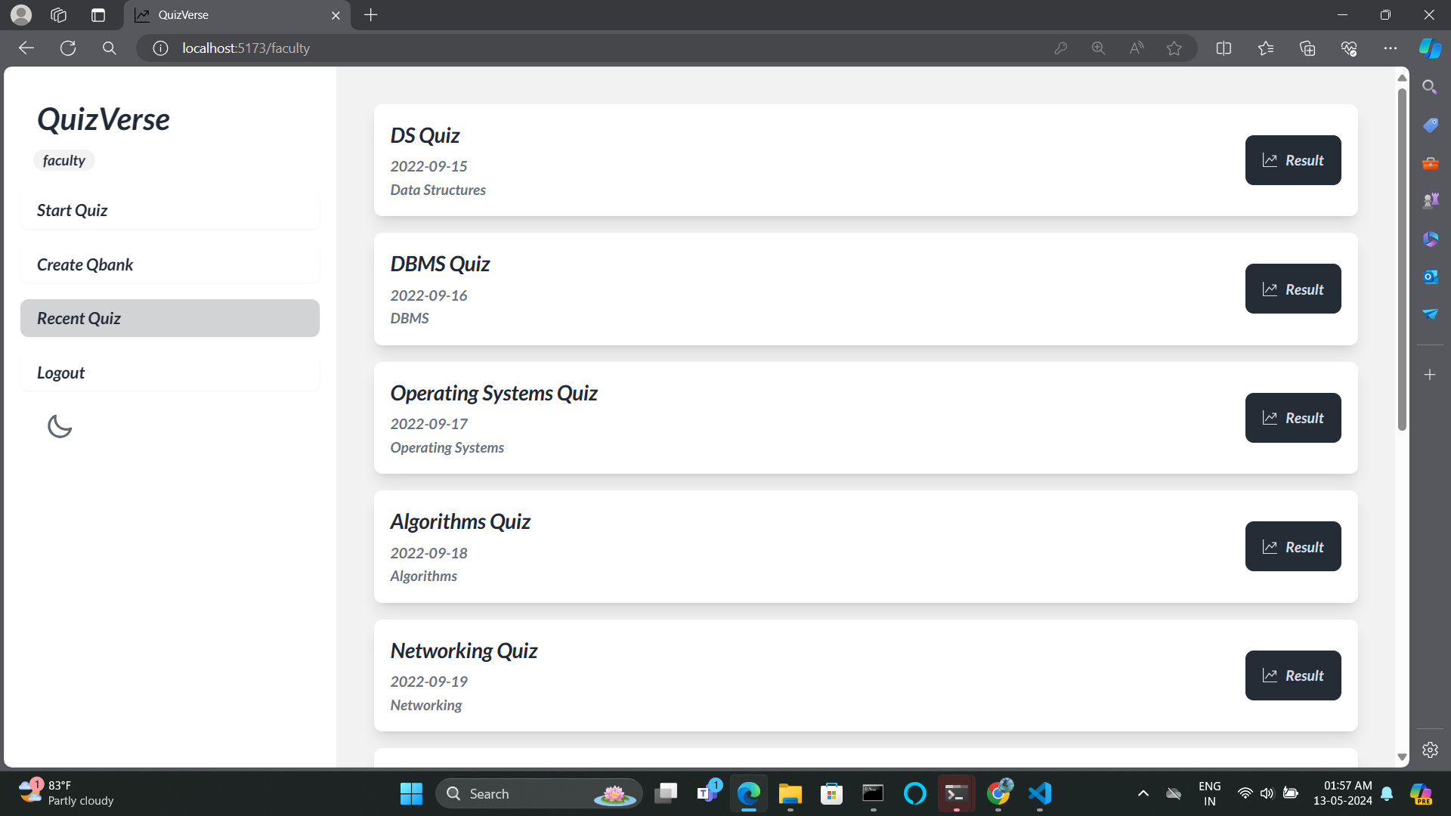

Slide 34
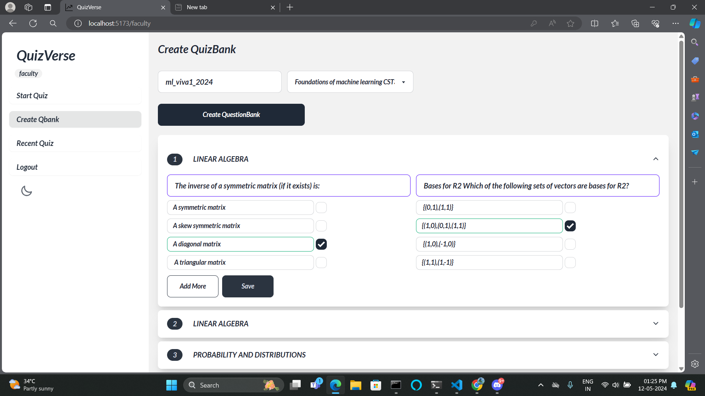

Slide 35
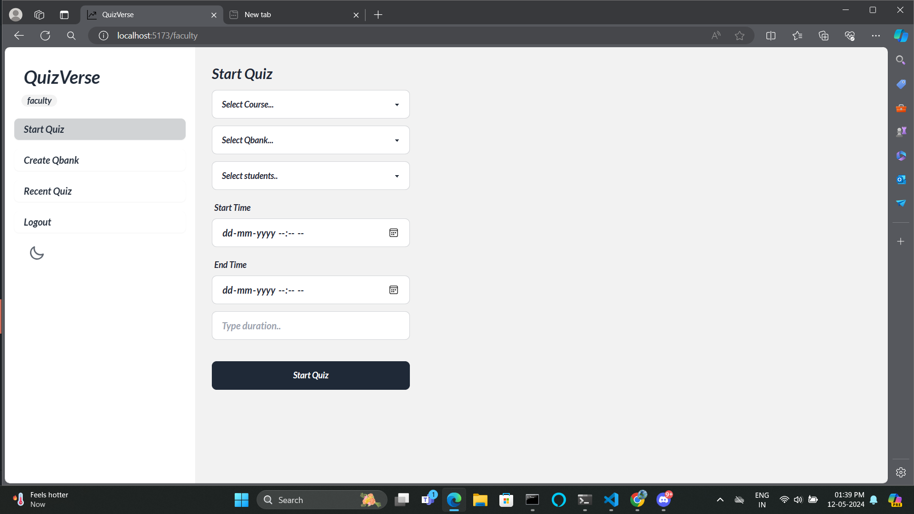

Slide 36
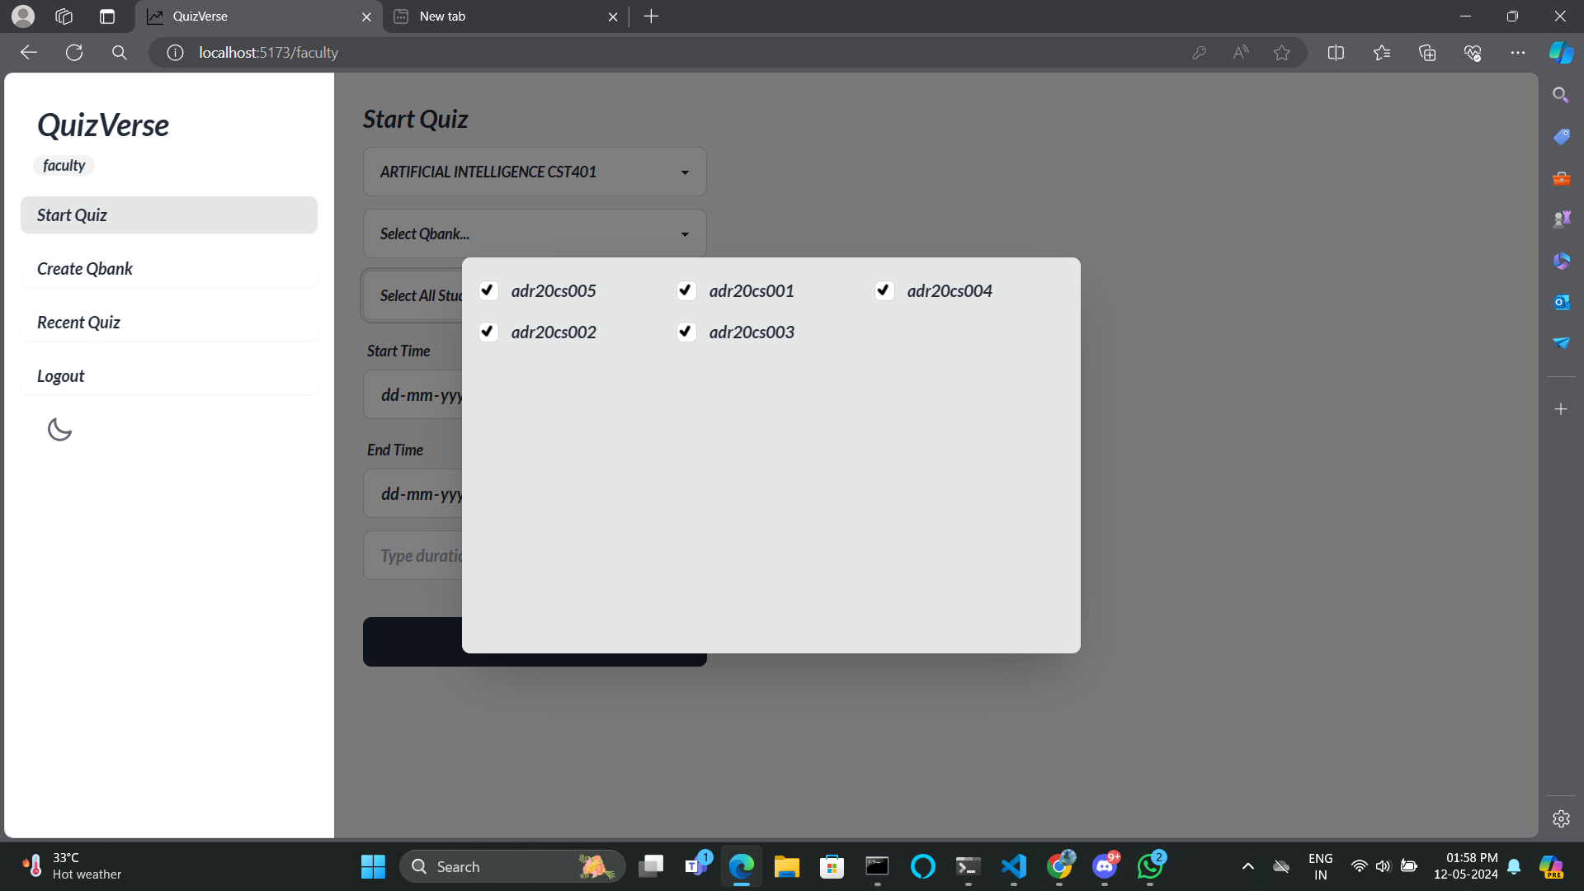

Slide 37
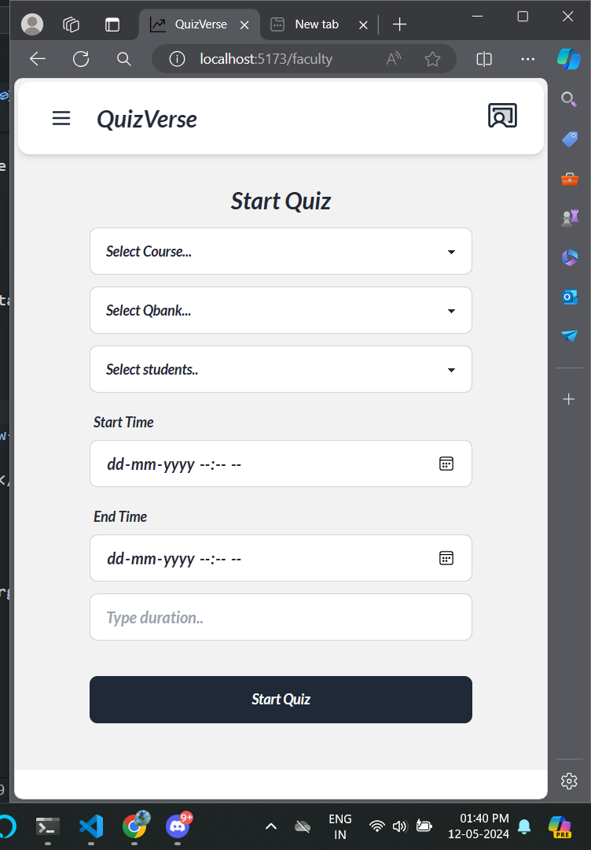
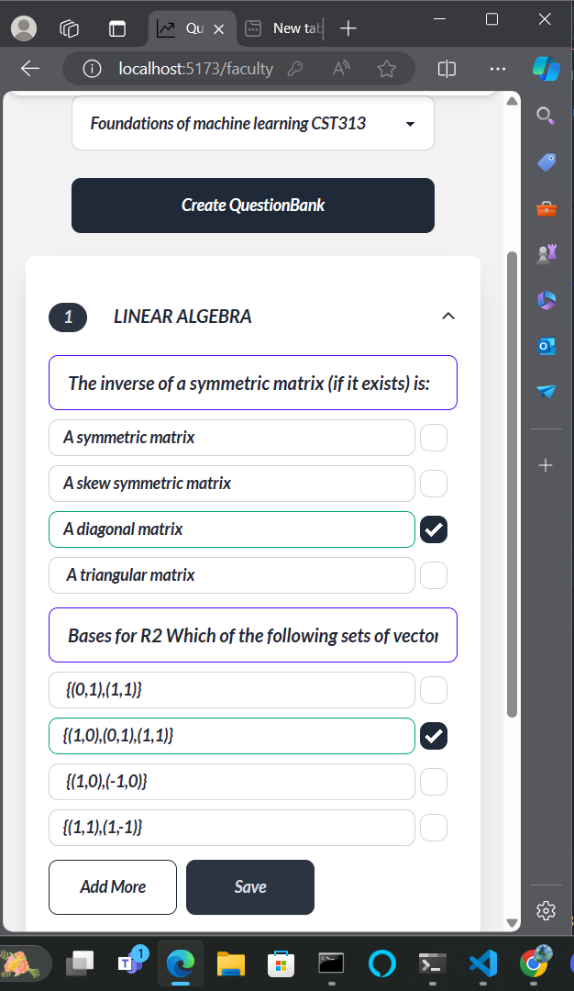

Slide 38
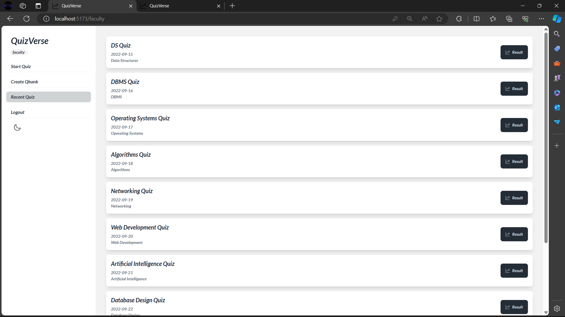

Slide 39
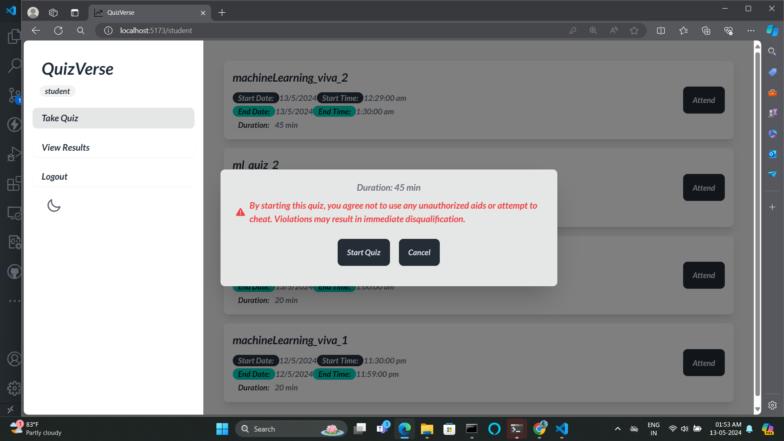

Slide 40
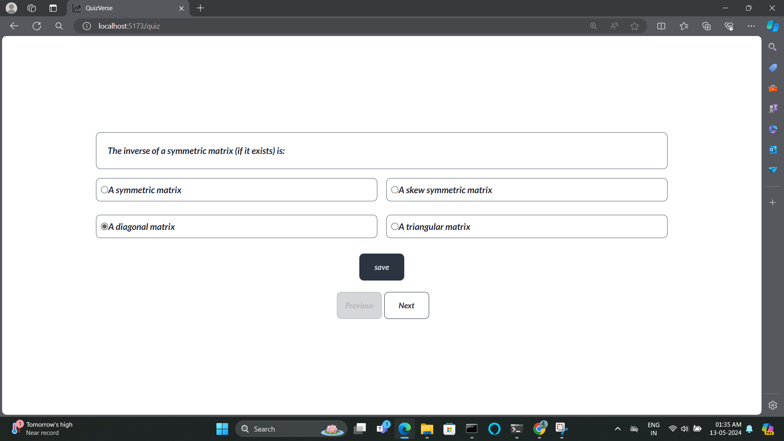

Slide 41
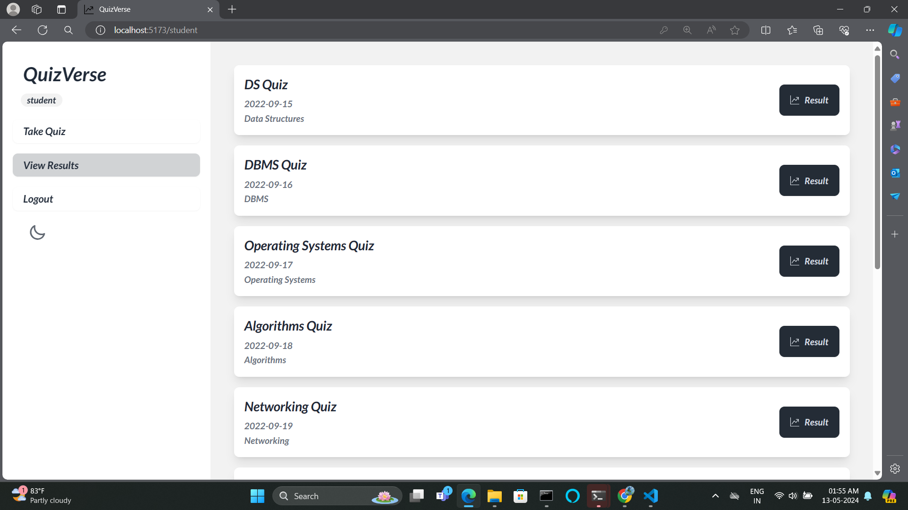

Slide 42
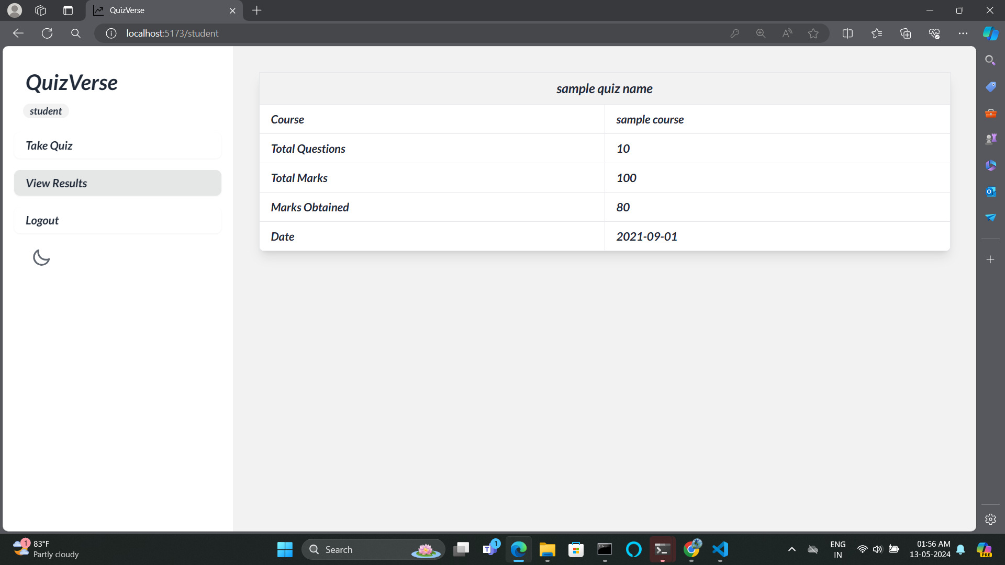

Slide 43
In summary, QuizVerse offers a fresh approach to exams that tackles the problems with traditional methods. It makes tests easier for teachers and more enjoyable for students. With its user-friendly design and strong security features, QuizVerse provides valuable insights into how well students are doing. By embracing QuizVerse, we're moving towards a future where exams are smarter, easier, and more inclusive, helping everyone learn better.
CONCLUSION

Slide 44
GOOGLE
IEEE RESEARCH PAPERS
CHATGPT
REFERENCES

Slide 45

THANKYOU

